Slide 1
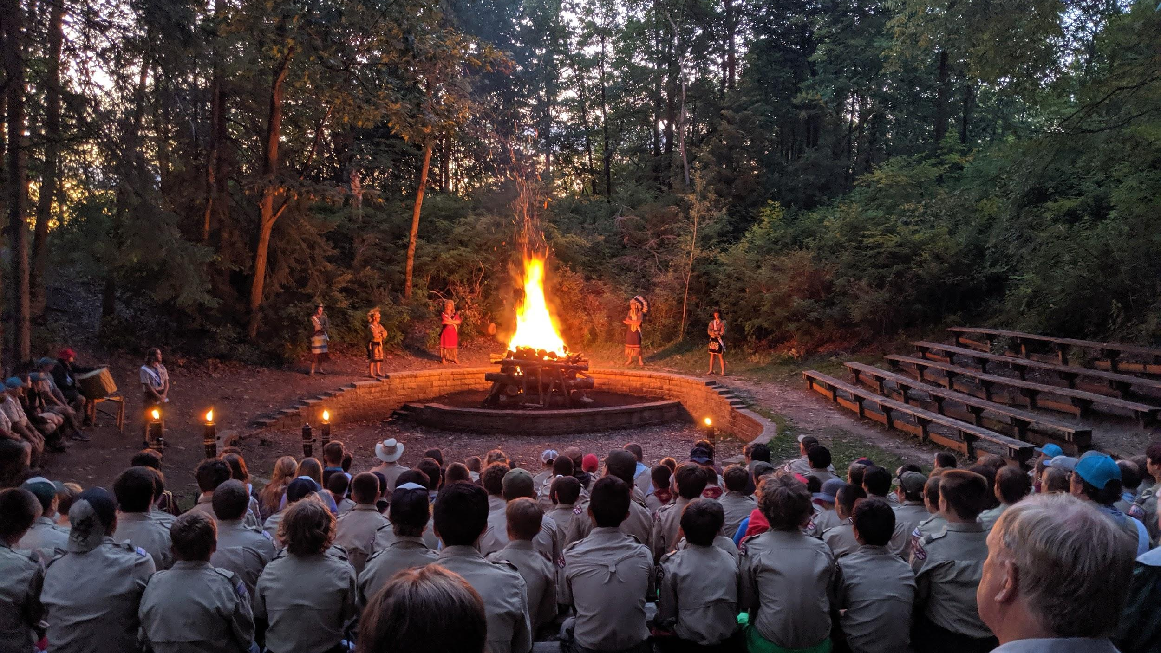
2021 OA Unit Election
Wag-O-Shag Lodge Order of the Arrow

Slide 2
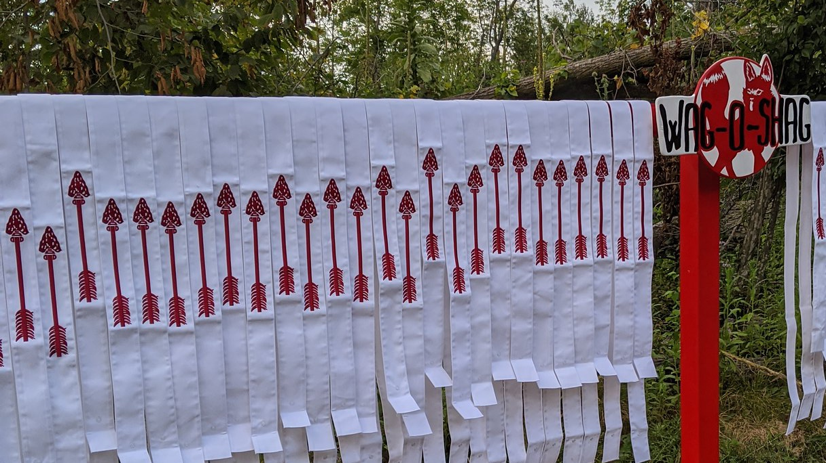
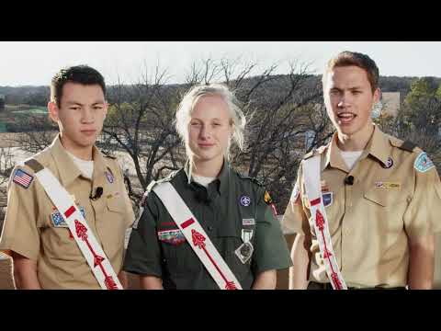
Video

Slide 3
OA Principles
To recognize scouts and scouter who best exemplify the Scout Oath and Law
To develop and maintain camping traditions and spirit
To promote scout camping
To crystalize the scout habit of helpfulness into a life of purpose of leadership in cheerful service to others

Slide 4
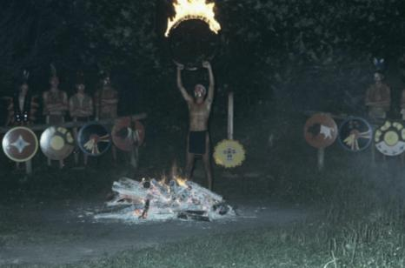
Lodge History
PAC Executive Charles G. Woodson conferred with Samoset Council Executive William Hoffman about starting a lodge for the Potawatomi Area Council.
Lodge approved and chartered on Oct. 21, 1944
Lodge name derived from “Waugoshance” meaning “little foxes”

Slide 5
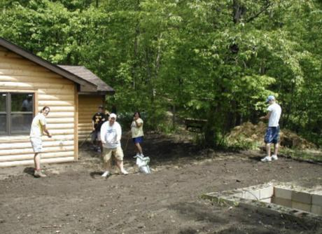
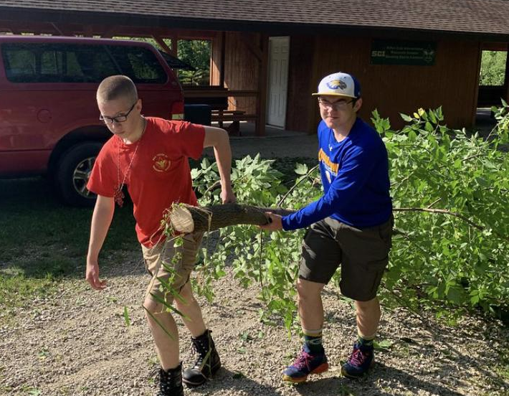
Wag-O-Shag and Camp Long Lake
Lodge comes together for many service events at Camp Long Lake including Fall and Spring Conference, Fireball, as well as various Ordeal Weekends
This year will be CLL’s 75th Anniversary
BE THERE for Summer Camp!

Slide 6
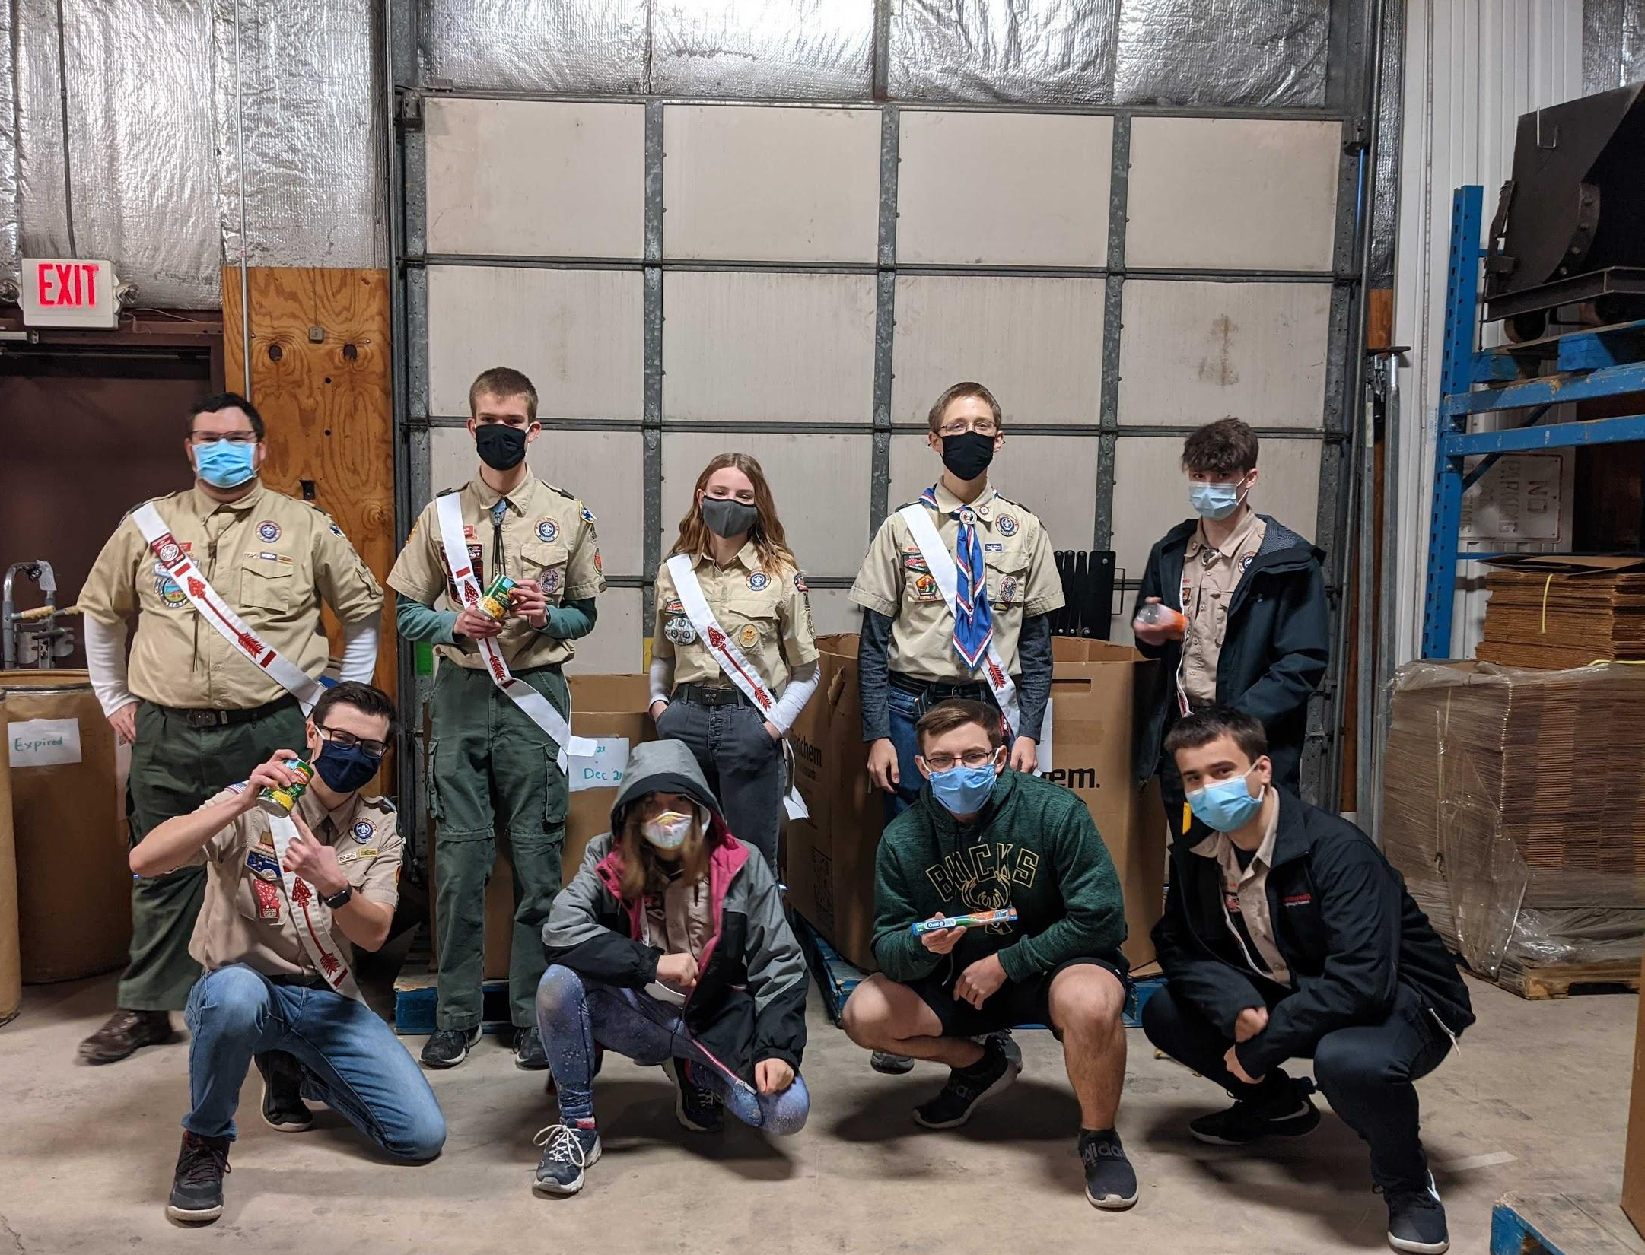
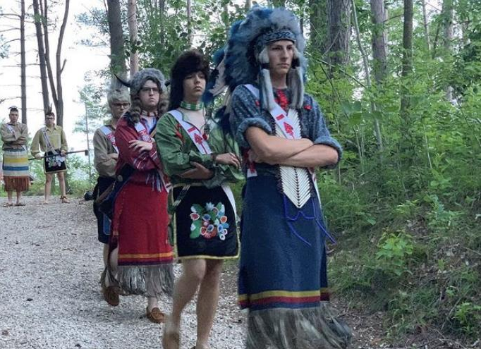
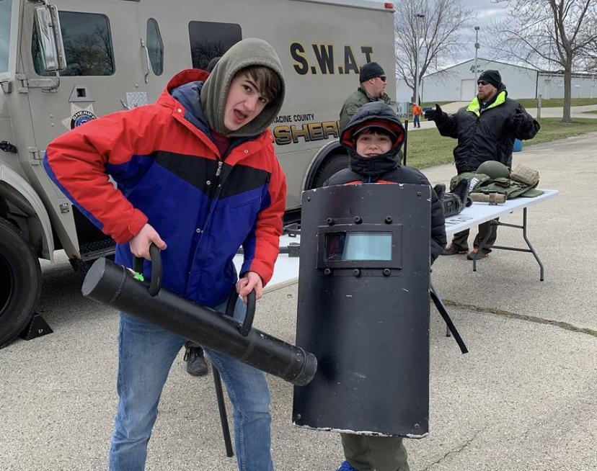
Our Lodge now
650+ registered members
Spring and Fall Conference
Winding
Chapter Events
Section Conclave
CLL Summer Program
OA Members, check out the Fox Newsletter and our Instagram page @wagoshag

Slide 7
Arrowmen Responsibility and Candidate Eligibility
An Arrowman’s primary obligation is to his/her unit
To provide leadership, promote camping, and setting the example for other scouts
To be eligible to join the OA, youth under the age of 21 must:
Be registered in a BSA unit,
Hold scouts BSA First Class Rank, Venturing Discovery Award, or Sea Scout Ordinary Rank, or higher in whichever type of unit is conducting the election,
Be active in their unit and have experienced 15 nights of camping in the past 2 years
Be approved by Troop Scoutmaster, Crew Advisor, or Ship Skipper.

Slide 8
Who to vote for?
Consider these questions about each candidate
Who is cheerful even when facing tiresome tasks?
Will he/she continue their service in the future?
Would you want to go camping with him/her?
Does he/she constantly live by the Scout Oath and Law?
Can you depend on this person?
This is NOT a popularity contest. Vote for the people who are most deserving of this honor

Slide 9
Virtual Voting Instructions
Voting will be done with Google Forms
Election Team will post a link to the form in the Zoom chat
Youth ONLY under the age of 21 are able to vote
Select the people you would like to vote for
If you think no one is worthy, select the “No one is worthy” check box
You are only allowed to vote once
If you and a sibling are sharing the same device to vote, ask the election team for an alternate ballot form.

Slide 10
Conclusion
A final result has been reached
Results will be announced at Callouts or when your Unit Leader deems it the appropriate time to do so
Thank you for voting!
OA members, remember to pay your 2021 dues!

